Slide 1
CSEc English A SBA
How to Complete the SBA

Slide 2
General Objectives:
The aim of this lesson is to:
help you understand the purpose of the plan of investigation
Develop your ability to write a plan of investigation for the English SBA using this knowledge

Slide 3
Specific Objectives:
At the end of this lesson, you should be able to:
Take notes about the requirements of the English A plan of investigation
Take notes regarding how one should be written
Observe examples of a the plan of investigation
Write a draft for the plan of investigation of your own, using a worksheet from the syllabus

Slide 4
What is the English SBA?
A research on a topic about a problem in society
An analysis of the language of the artefacts used to express thoughts on this problem in society (individual and group effort)
A reflection on the information and language in these artefacts, and your growth as a student in the process
An oral presentation using your new found knowledge and appreciation of the varieties of language

Slide 5
What the English SBA is NOT
NOT a Social Studies SBA

Slide 6
What are the aims of the syllabus that guide the English SBA?

Slide 7
Graded parts of the SBA (and mark scheme):
Total - 45 marks
Individual
Individual
Plan of Investigation (5 marks)
Participation Measure (5 marks)
Quality of Group Activity (10 marks)
Group Report (10 marks)
Reflections (5 marks)
Oral Presentation (10 marks)
Individual
Group
Group
Group

Slide 8
Parts of the SBA to include in your portfolio:
Plan of Investigation
Reflections: Entry 1, Entry 2, Entry 3
Group Report
Oral Presentation Plan
Oral Presentation
Artefacts

Slide 9
The plan of investigation

Slide 10
What is a Plan of Investigation?
It is an introduction to the topic/theme/issue of your research
“It is a plan outlining how you or your investigator intends to conduct the investigation. For project managers it can be a critical tool. It will outline what is to undertaken, how it is to be done, processes, procedures and policies to be used, the order of interviews, and risks.” (http://www.wiseworkplace.com.au/knowledge-hub/investigation-practice/investigation-plans)

Slide 11
Why write a Plan of Investigation?
It helps you focus on what you need to do and how
It gives the person reading your research an idea of the focus on your research

Slide 12
How do you write a POI?
Follow these steps to complete your plan:
State your research question. You should briefly explain and justify the reasons for choosing your theme.
Define the scope of the investigation. You should clearly identify the themes or lines of argument to be considered in your research.
Explain the method used.
Source: http://www.mrbuddhistory.com/a-plan-of-the-investigation.html

Slide 13
The Plan of Investigation
Click on this link to see a presentation on this:
https://prezi.com/p/z3gmf38ok574/english-sba-plan-of-investigation/

Slide 14
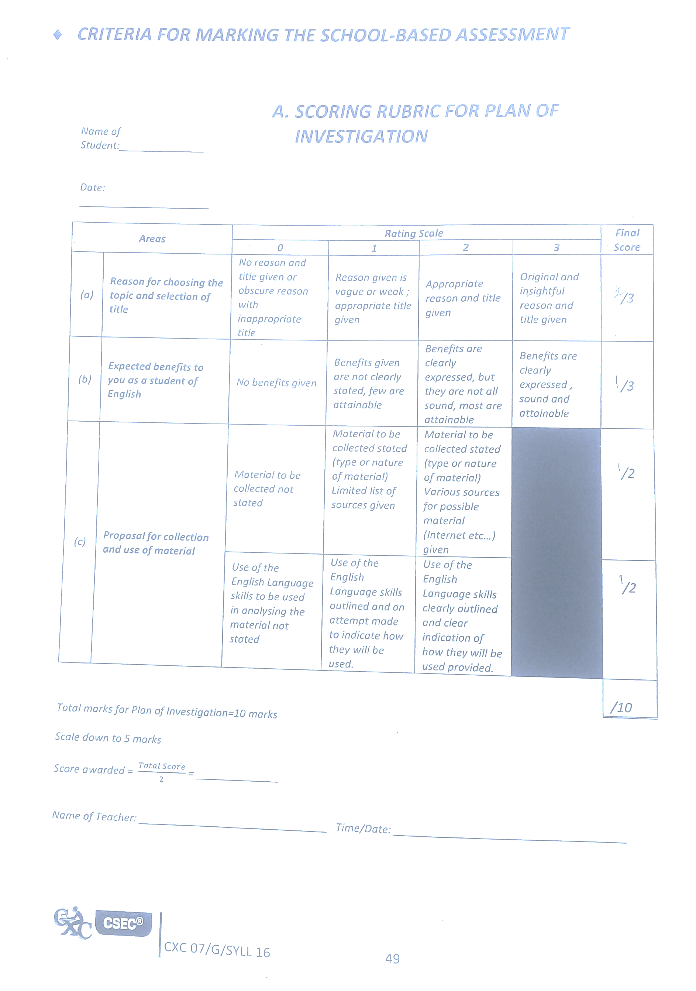
Mark Scheme/Rubric for Plan of Investigation
Reason for choosing the topic and selection of title – 3 marks
Expected benefits to you as a student of English – 3 marks
Proposal for collection and use of material – 4 marks :
Material to be collected – 2 marks
English Language Skills to be used in analysing material – 2 marks
Total – 10 marks

Slide 15
Your POI should answer the following questions:
What is your chosen theme and subtopic?
Why did you choose the issue/topic/theme?
What are the expected benefits to you as an English student? Consider how it will impact your vocabulary, knowledge, research skills, discussions and other aspects of your performance in English.
How do you plan to collect relevant information on your issue/topic/theme and use specific English skills to analyse the pieces?
Source: http://cxcenglishastudyhub.blogspot.com/2019/03/english-sba-plan-of-investigation.html

Slide 16
Sample of a Plan of Investigation
Topic
My group members and I have chosen the theme skin bleaching. I will be focusing on: The negative effects of skin bleaching. I have chosen this topic because I have observed that skin bleaching is quite common in my society and I have noticed how it has changed the appearance of people I know. I would like to know more about its negative effects, so I can educate my friends and family about the dangers of this practice, so they can avoid doing it.
subtopic
reason

Slide 17
Benefits
Engaging in this research will be most beneficial to me because it will enhance my competence as an English student. It will build my vocabulary because I will come across different words and terms as I search for the most appropriate pieces. An increased vocabulary will also improve my written expression and reading comprehension.
1
2
3

Slide 18
Proposal
I intend to gather information for my topic by consulting a variety of sources for meaningful information. I will visit the library and browse the internet for articles, poems and pictures on my topic and consult YouTube for potential videos. I aim to use an online article, a picture and a YouTube video that show the effects of skin bleaching for my pieces. These pieces will be further analysed by identifying the writer’s techniques, devices and evaluating how these are used to achieve the purpose of the pieces. All this will be done to see how the pieces contribute to the overall theme and my sub-topic.
Source: http://cxcenglishastudyhub.blogspot.com/2019/03/english-sba-plan-of-investigation.html
1
2

Slide 19
Sample POI
Where does she/he plan to find his/her artefacts?
What are the artefacts he/she plans to use?
How many artefacts does he/she mention will be used?
What will he/she do once he/she has found these artefacts?

Slide 20
Individual work
Your Turn!
Write the first draft of your plan of investigation using the worksheet from the syllabus (pages 53 – 55)
100-150 words
First, just fill in the blank spaces for each question before you begin to write your paragraphs.

