Slide 1
MATH WHIZZ
MATRICES
PRESENTER: MR G. WILLIAMS

Slide 2
1
Explain basis concepts associated with matrices;
Addition and subtraction of matrices of the same
order;
2
Solve problems involving multiplication of
conformable matrices;
3
Solve problems involving the determinant and
adjoint of a 2x2 matrix;
4
5
Obtain the inverse of a non-singular 2x2 matrix;
6
Use of matrices to solve linear simultaneous equations
With two unknowns.

Slide 3
What is a Matrix?
A matrix is a rectangular arrangement of numbers, letters or a combination of both.
A matrix is formed when the above mentioned are arranged in rows and columns.
Rows:- Horizontal arrangement
Columns:- Vertical arrangement
The number of rows and columns a matrix has, gives its individual name.

Slide 4
Order of a Matrix
1 row
2 columns
3 rows
1 x 2 matrix
4 columns
3 x 4 matrix
2 rows
2 columns
2 x 2 matrix
2 rows
1 column
2 x 1 matrix

Slide 5
Addition & Subtraction
You can add and subtract matrices ONLY when they have the same order.
Elements in the SAME positions are added or subtracted.
8
–2
5
–4
8 + 5
-2+(-4)
13
–6
+
=
=
7
0
1
–3
7 + 1
0+(-3)
8
–3
8
–2
5
–4
8 – 5
-2–(-4)
3
2
–
=
=
7
0
1
–3
7 – 1
0 – (-3)
6
3

Slide 6

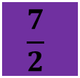




Scalar Multiplication
When multiplying a matrix by a scalar quantity, each element in the matrix is multiplied by that quantity.
8
–2
2 x 8
2 x (–2)
16
–4
2
=
=
7
0
2 x 7
2 x 0
14
0
$\frac{1}{2}$ x 8
$\frac{1}{2}$ x (–2)
4
–1
$$\frac{1}{2}$$
8
–2
=
=
7
0
$\frac{1}{2}$ x 7
$\frac{1}{2}$ x 0
$$\frac{7}{2}$$
0

Slide 7
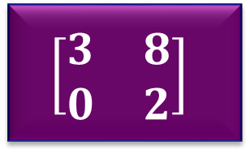
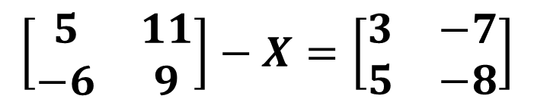
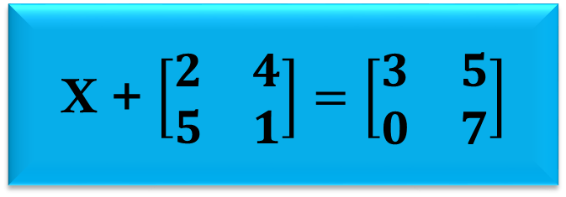
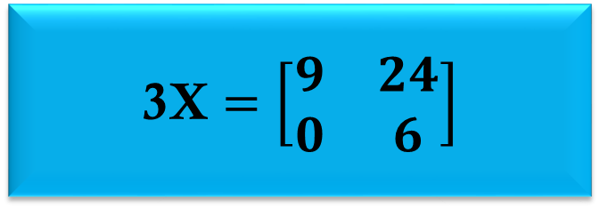
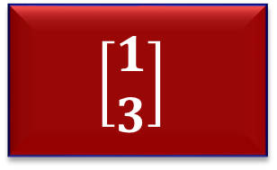
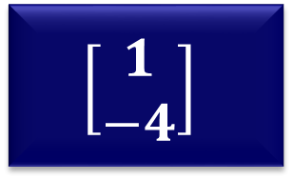
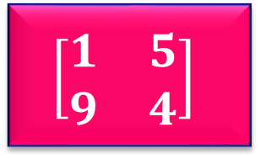
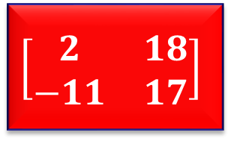
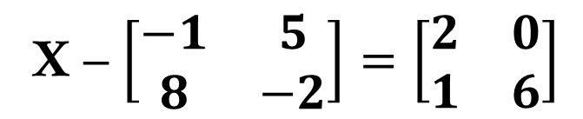
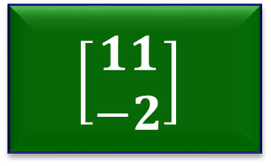
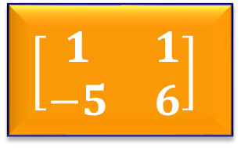
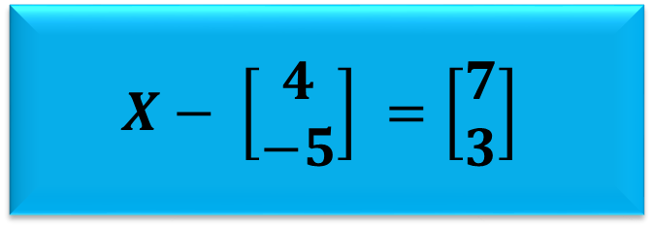
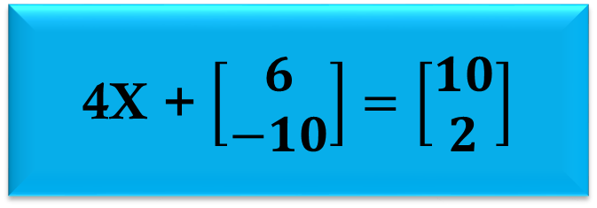
Find the value of each calculation. Can you match them to the matrices below?
Math Vault
X + $\left[\begin{matrix}2 & 4 \\ 5 & 1\end{matrix}\right]=\left[\begin{matrix}3 & 5 \\ 0 & 7\end{matrix}\right]$
3X $=\left[\begin{matrix}9 & 24 \\ 0 & 6\end{matrix}\right]$
X – $\left[\begin{matrix}−1 & 5 \\ 8 & −2\end{matrix}\right]=\left[\begin{matrix}2 & 0 \\ 1 & 6\end{matrix}\right]$
$$X− \left[\begin{matrix}4 \\ −5\end{matrix}\right] =\left[\begin{matrix}7 \\ 3\end{matrix}\right]$$
4X + $\left[\begin{matrix}6 \\ −10\end{matrix}\right]$ $=\left[\begin{matrix}10 \\ 2\end{matrix}\right]$
$$\left[\begin{matrix}5 & 11 \\ −6 & 9\end{matrix}\right]−X=\left[\begin{matrix}3 & −7 \\ 5 & −8\end{matrix}\right]$$
$$\left[\begin{matrix}11 \\ −2\end{matrix}\right]$$
$$\left[\begin{matrix}3 & 8 \\ 0 & 2\end{matrix}\right]$$
$$\left[\begin{matrix}1 \\ −4\end{matrix}\right]$$
$$\left[\begin{matrix}1 \\ 3\end{matrix}\right]$$
$$\left[\begin{matrix}2 & 18 \\ −11 & 17\end{matrix}\right]$$
$$\left[\begin{matrix}1 & 5 \\ 9 & 4\end{matrix}\right]$$
$$\left[\begin{matrix}1 & 1 \\ −5 & 6\end{matrix}\right]$$

Slide 8
Matrix Multiplication
For matrices to be multiplied together, the number of columns in the first must be equal to the number of rows in the second.
3 x 4
4 x 3
1 x 2
2 x 2
2 x 2
2 x 2

Slide 9


If $A=\left[\begin{matrix}3 & 5 \\ 1 & 0\end{matrix}\right]$ and $B=\left[\begin{matrix}−1 & 3 \\ −2 & 4\end{matrix}\right]$
Multiplying matrices together involves multiplying the elements in the rows of the first matrix by the elements in the columns of the second matrix.
Find the product of AB
SOLUTION
-13
29
$AB=\left[\begin{matrix}3 & 5 \\ 1 & 0\end{matrix}\right]\left[\begin{matrix}−1 & 3 \\ −2 & 4\end{matrix}\right]$ $=$
-1
3
COLUMNS IN B
We can ONLY multiply corresponding elements.
-1
3
-2
4
3
5
-3 + (-10)
9 + 20
ROWS IN A
1
0
-1 + 0
3 + 0

Slide 10


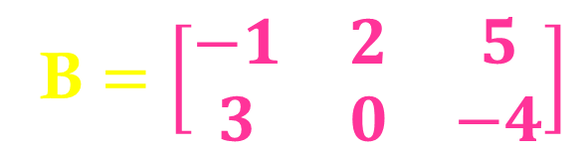









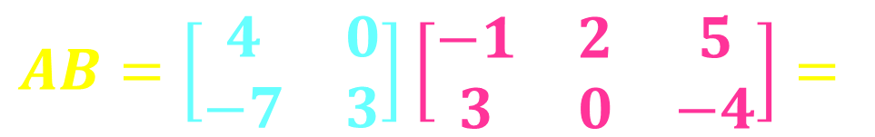


$$A=\left[\begin{matrix}4 & 0 \\ −7 & 3\end{matrix}\right]$$
B $=\left[\begin{matrix}−1 & 2 & 5 \\ 3 & 0 & −4\end{matrix}\right]$
Calculate the matrix product of AB
$$AB=\left[\begin{matrix}4 & 0 \\ −7 & 3\end{matrix}\right]\left[\begin{matrix}−1 & 2 & 5 \\ 3 & 0 & −4\end{matrix}\right]=$$
-4
8
20
16
-14
-47
$$\left[\begin{matrix}4 & 0\end{matrix}\right]$$
$$\left[\begin{matrix}−1 \\ 3\end{matrix}\right]$$
$$\left[\begin{matrix}4 & 0\end{matrix}\right]$$
$$\left[\begin{matrix}2 \\ 0\end{matrix}\right]$$
$$\left[\begin{matrix}4 & 0\end{matrix}\right]$$
$$\left[\begin{matrix}5 \\ −4\end{matrix}\right]$$
= 4(-1) + (0)(3)
= 4(2) + (0)(0)
= 4(5) + (0)(-4)
$$\left[\begin{matrix}−7 & 3\end{matrix}\right]$$
$$\left[\begin{matrix}−1 \\ 3\end{matrix}\right]$$
$$\left[\begin{matrix}−7 & 3\end{matrix}\right]$$
$$\left[\begin{matrix}2 \\ 0\end{matrix}\right]$$
$$\left[\begin{matrix}−7 & 3\end{matrix}\right]$$
$$\left[\begin{matrix}5 \\ −4\end{matrix}\right]$$
= (-7)(-1) + (3)(3)
= (-7)(2) + (3)(0)
= (-7)(5) + (3)(-4)

Slide 11

Determinant of 2x2 Matrix
The determinant of Matrix A is written as
a
b
If Matrix A is:
Then the determinant is:
c
d
|A|
=
a
d
–
b
c
When
a
d
–
b
c
=
0
the matrix is SINGULAR.
When
a
d
–
b
c
$$≠$$
0
the matrix is NON-SINGULAR.

Slide 12
-4
-5
6
1
A =
C =
7
8
12
2
Then the determinant is:
Then the determinant is:
|A|
=
-4
8
–
-5
7
|C|
=
6
2
–
1
12
=
-32
–
-35
=
12
–
12
=
3
=
0
Since the determinant is NOT equal to zero, A is a non-singular matrix.
Since the determinant is equal to zero, C is a singular matrix.

Slide 13
Adjoint of 2x2 Matrix
a
b
If Matrix A is:
Switch the positions of the leading diagonal (a and d interchange places)
c
d
Then the adjoint is:
ONLY change the signs of the
non-leading diagonal.
d
-b
Adj.A =
-c
a

Slide 14
-4
-5
5
0
-4
-1
A =
B =
C =
7
8
-3
1
-9
-3
8
5
1
0
-3
1
Adj.A =
Adj.B =
Adj.C =
-7
-4
3
5
9
-4
0
3
10
-8
1
0
D =
E =
F =
0
-7
8
4
0
-1
-7
-3
4
8
-1
0
Adj.D =
Adj.E =
Adj.F =
0
0
-8
10
0
1

Slide 15


Inverse of a 2x2 Matrix
The inverse of Matrix A is written as $A^{−1}$
To find the inverse of a matrix, the steps are as follow:
1. Find the determinant
3. Find the Inverse of A
|A|
=
a
d
–
b
c
$$\frac{1}{ad −bc}$$
d
-b
$A^{−1}$ =
-c
a
2. Find the Adjoint of A
d
-b
Adj.A =
-c
a

Slide 16



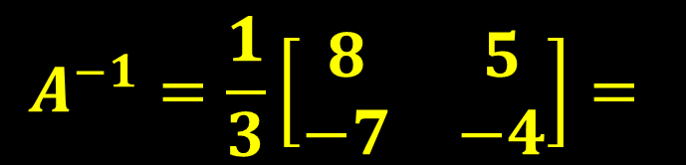
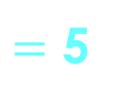






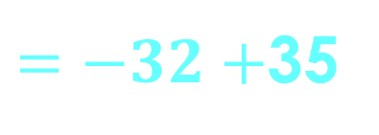

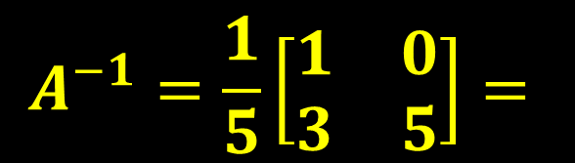
-4
-5
5
0
Given A =
Given B =
7
8
-3
1
Find the inverse of A , $A^{−1}$.
Find the inverse of B , $B^{−1}$.
SOLUTION
SOLUTION
$\left|A\right|=\left(−4\right)\left(8\right)−\left(−5\right)\left(7\right)$
$\left|B\right|=\left(5\right)\left(1\right)−\left(−3\right)\left(0\right)$
$=−32+$35
$$=3$$
$$=5+0$$
$=$ 5
$$Adj. A=\left[\begin{matrix}8 & 5 \\ −7 & −4\end{matrix}\right]$$
$$Adj. A=\left[\begin{matrix}1 & 0 \\ 3 & 5\end{matrix}\right]$$
$$\left[\begin{matrix}\frac{8}{3} & \frac{5}{3} \\ \frac{−7}{3} & \frac{−4}{3}\end{matrix}\right]$$
$$\left[\begin{matrix}\frac{1}{5} & 0 \\ \frac{3}{5} & 1\end{matrix}\right]$$
$$A^{−1}=\frac{1}{3}\left[\begin{matrix}8 & 5 \\ −7 & −4\end{matrix}\right]=$$
$$A^{−1}=\frac{1}{5}\left[\begin{matrix}1 & 0 \\ 3 & 5\end{matrix}\right]=$$

